Slide 1



Workshop II
EnergyPlus Python API Hussein Elehwany – Carleton University

Slide 2
Agenda
09:00-09:45
Background on EMS
Benefits of Python EMS
09:45-10:30
Running simulation with Jupyter Notebook
Introducing handles
10:30-10:50: Coffee break
10:50-11:35
Reading and writing from/to simulation
11:35-12:20
Hands-on exercise
Python plugin mode

Slide 3

About presenter
Hussein Elehwany (He/Him)
Carleton University | 2021-present PhD on utilizing reinforcement learning in occupant-centric controls Supervised by Prof. Gunay & Prof. Ouf
Carl Zeiss, Germany | 2017-2021 Thermal Engineer for precision machinery
Technical University of Munich | 2014-2017 MSc in power engineering

Slide 4
Software requirements
Python
Jupyter notebook or other IDE
EnergyPlus – version 9.3 or later (recommended version 23 or 24)
Files needed: Github: https://github.com/husseinelehwany/EnergyPlus-python-EMS.git

Slide 5

EnergyPlus
An open-source whole building energy performance simulation program
Managed by NREL
Some pros
Summary and detailed output
Built-in HVAC and lighting control strategies
User-defined schedules
Extensible runtime scripting system for user-defined control:
Energy Management System (EMS)

Slide 6
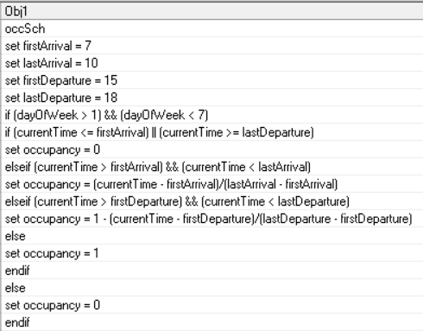
Energy Management System (EMS)
Using EnergyPlus Runtime Language (ERL)
Access sensor data
Perform high-level control
Change actuators and setpoints

Slide 7
Why to use Python API ?
Exchange data while a simulation is running.
Develop routines to manipulate internal variables.
Call these routines at pre-determined times (e.g., at the start of each HVAC iteration or at every time step, etc.
The ease of using python and utilizing all its libraries.
Nested loops and user-defined functions
Objects and data structures, e.g., Numpy & Pandas.
Developing machine learning models. E.g. Scikit-learn, TensorFlow, PyTorch, etc.

Slide 8

Simulation timeline without EMS
Weather data
Preprocessing
Simulation Runtime
Outputs
Temperatures
Energy use
EnergyPlus Schedule
OR

Slide 9

Simulation timeline with EMS
Weather data
Preprocessing
Simulation Runtime
Outputs
Temperatures
Energy use
Read
temperatures
write
setpoints
Control
method

Slide 10
Modes of using the API
EnergyPlus Python API
EnergyPlus library
Python plugin
run EnergyPlus from Python script
run EnergyPlus using
EP-launch and the simulation calls a python script

Slide 11
EnergyPlus Python API functions
Runtime API: calls python callback functions from within EnergyPlus at specific points.
Data-transfer API: get sensor and actuator data.
Functional API: fluid and refrigerant property methods.

Slide 12
Examples of callback functions
callback_after_new_environment_warmup_complete
callback_begin_new_environment
callback_begin_system_timestep_before_predictor
callback_end_system_sizing

Slide 13
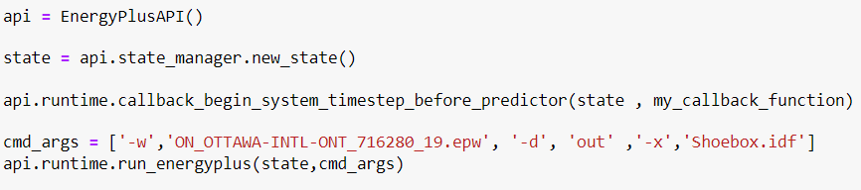
Initialization

Slide 14
Opening Jupyter Notebook
Download notebook
Open cmd
Go to directory containing notebook file
Type jupyter notebook

Slide 15
Variable handles
Handles are pointers to point to different EnergyPlus variables and actuators.
Variables called by the script should be defined in the IDF file.
There are 3 types of handles:
Variable handles.
Meter handles.
Actuator handles.

Slide 16
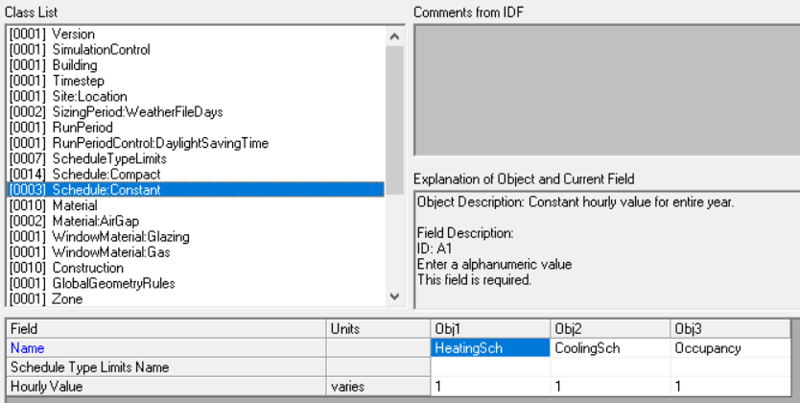
Actuators via schedules

Slide 17
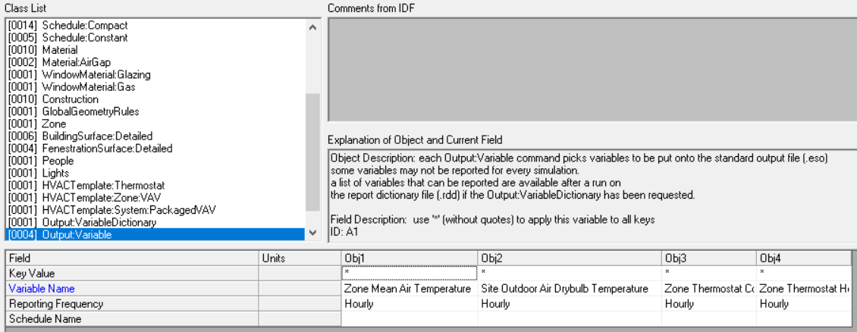
Variable handles
Location

Slide 18
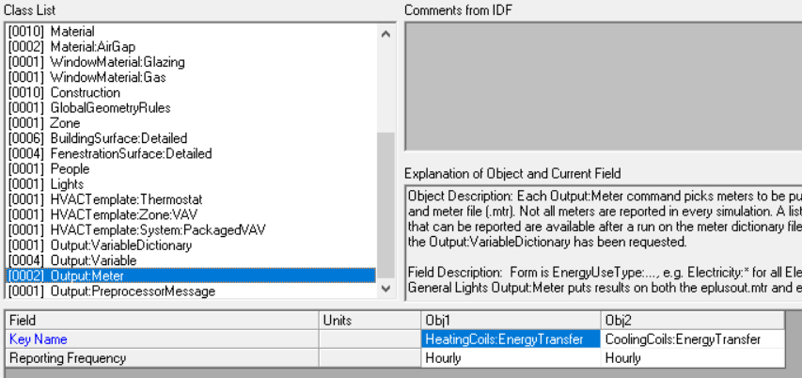
Meter handles

Slide 19
Good practices
Handles should be read only once
At every time step, actuators should be updated only once

Slide 20
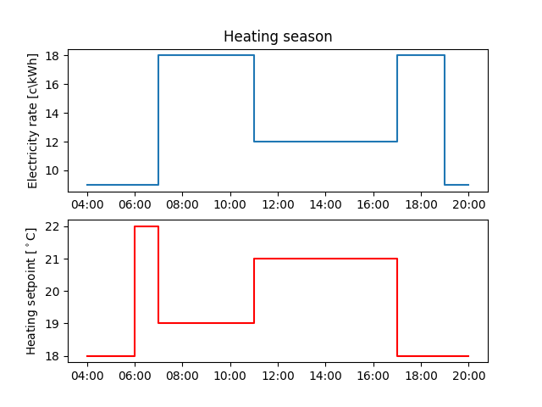
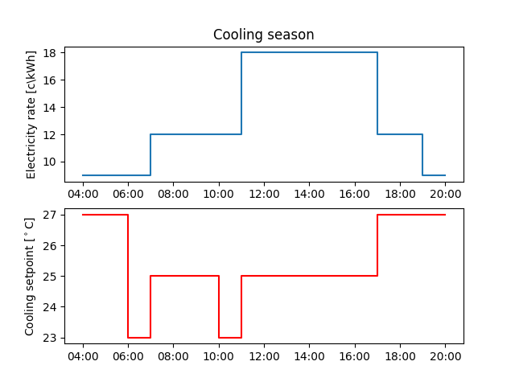
Hands-on exercise

Slide 21

References
EnergyPlus Python API documentation: https://nrel.github.io/EnergyPlus/api/python/
Github repository

Slide 22
Thank You
Questions?
husseinelehwany@cmail.carleton.ca

